Slide 1
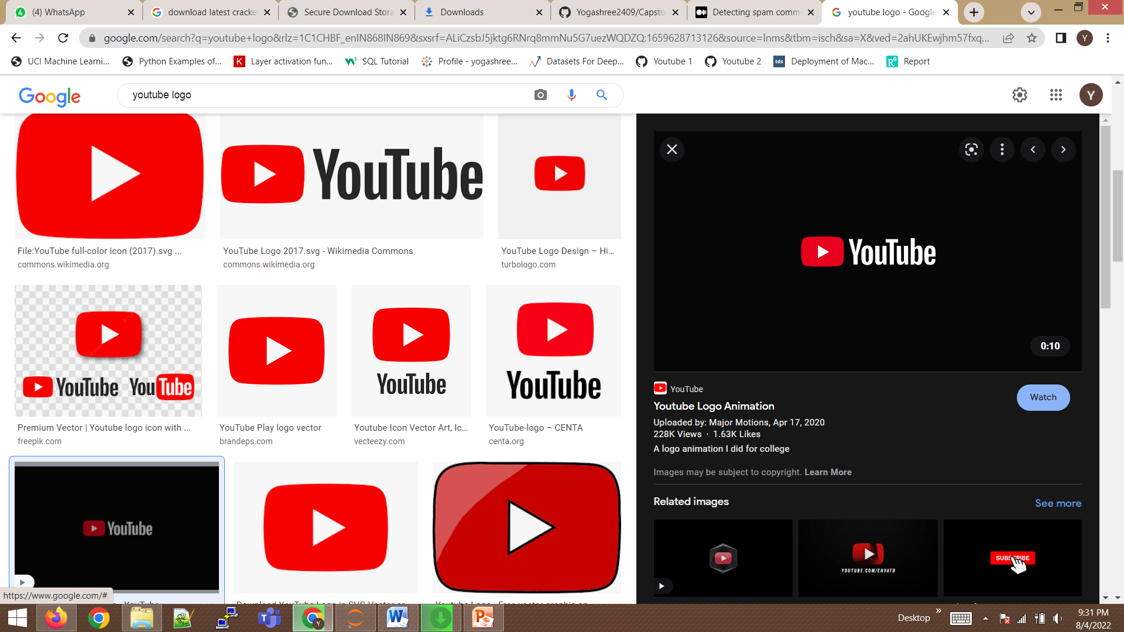
Youtube Spam Collection
Yogashree Mohan

Slide 2
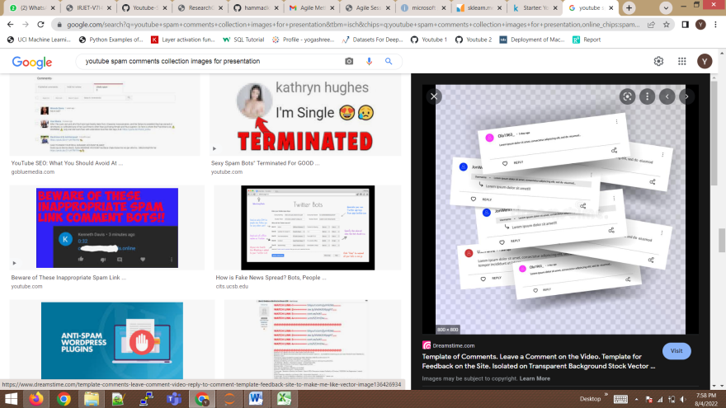
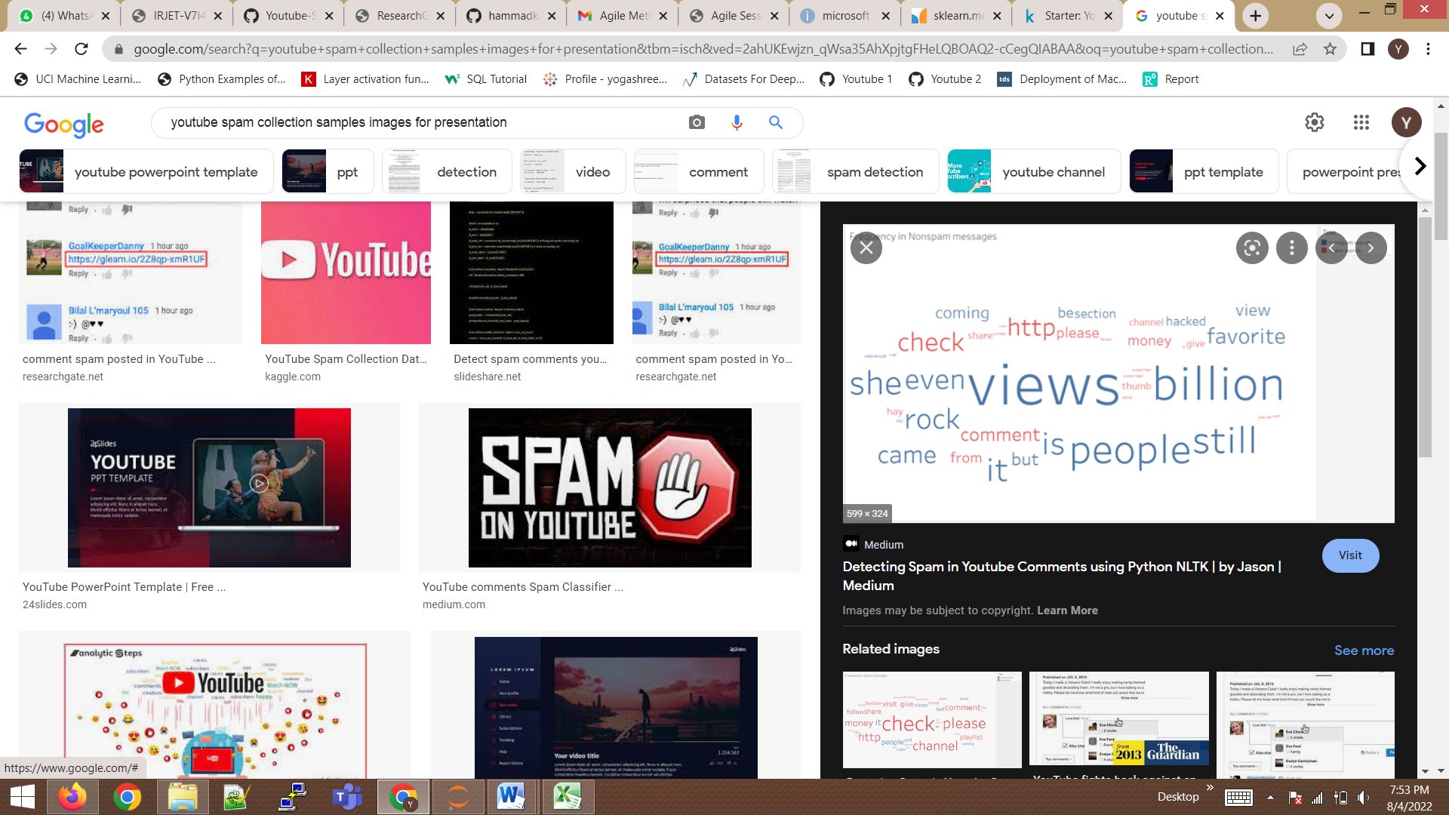
Objective
As many people upload videos in “YouTube” on the daily basis and a amount of comments posted on that videos are spam (i.e) people trying to promote their channel or market their product. To tackle this problem in this project we needed to identify the class of the YouTube video comments that it belongs to spam or ham.

Slide 3
Flowchart
Model Selection
Dataset
Preprocessing
Feature Selection
Feature Extraction
Feature Engineering
Train and Test split
Applying
test values
Model
Prediction

Slide 4
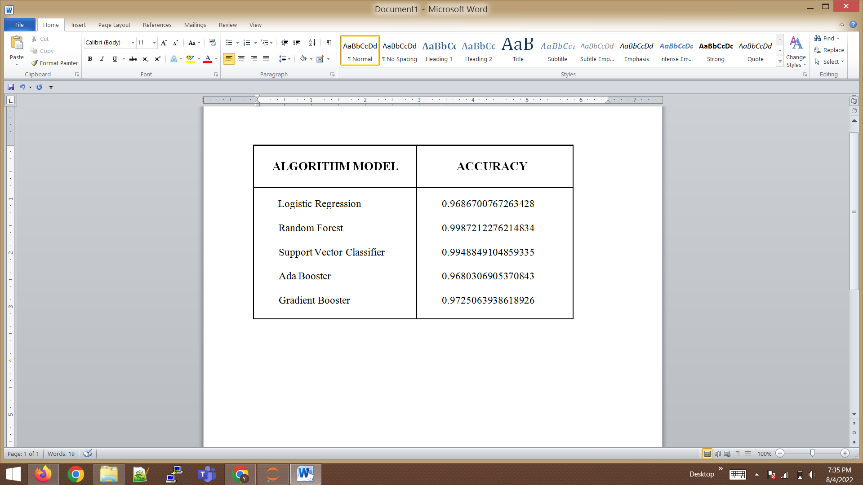
Model Accuracy

Slide 5
Conclusion
The goal of this research was to find capable methods and settings
that could be used to help the detection of spam comments
on YouTube.
For classifying the YouTube comments as spam and
not spam (ham) there are various techniques used.
From the model accuracy table the “random forest” has the best accuracy for predicting the spam or ham comments in youtube.
In real world, YouTube spam feature will not be constant it keeps on changing an precipitous way.

Slide 6
Capstone Project Link:
https://github.com/Yogashree2409/Capstone-Project.git
THANK YOU

